Slide 1



Enhanced Fuzzy Sentiment Detection in Cricket Tweets using CNN and BERT Hybrid Models
Name: Ashish Kumar
Roll No: 7315
T.E COMP-B
Guide: Prof. Mangesh Hajare
Department: Computer Engineering
Institute: Army Institute of Technology, Pune

Slide 2
INTRODUCTION
Cricket generates massive public engagement on social media, especially Twitter, where fans express emotions in real time.
Tweets often mix multiple emotions such as joy, disappointment, sarcasm, or frustration, making their analysis challenging.
Traditional sentiment models struggle with such fuzzy or ambiguous language.
The proposed system introduces a hybrid CNN–BERT–Fuzzy model that combines deep contextual understanding with linguistic uncertainty handling.
It classifies tweets into five emotion categories: Elated, Pleased, Unbiased, Displeased, and Frustrated for accurate sports sentiment interpretation.
2

Slide 3


PROBLEM STATEMENT
Tweets related to cricket often contain ambiguous or overlapping emotions, making it difficult to assign a clear sentiment label.
Traditional models misinterpret mixed opinions, sarcasm, and vague phrases like “almost good” or “not too bad”.
Deep models like BERT, though powerful, still lack mechanisms to quantify fuzziness or uncertainty in text.
Imbalanced emotional classes in real-world cricket datasets lead to biased sentiment prediction.
Hence, the key challenge is: “How can a hybrid model combining CNN, BERT, and fuzzy linguistic reasoning accurately detect uncertain or ambiguous sentiments in cricket tweets?”
3

Slide 4
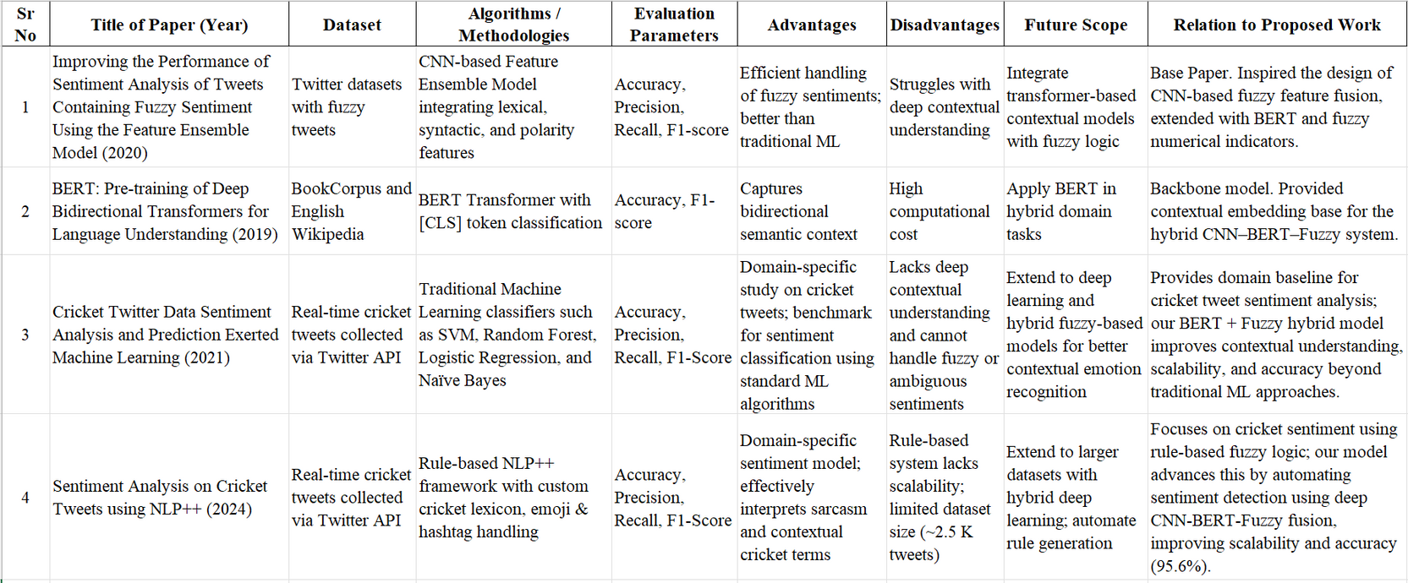
LITERATURE REVIEW
4

Slide 5
GAPS IDENTIFIED
Existing sentiment models fail to handle fuzzy or mixed emotional expressions common in short cricket tweets.
Deep learning models like BERT capture context well but lack mechanisms to represent linguistic uncertainty.
Most prior works focus on generic product reviews or binary sentiments, not domain-specific, multi-class sports tweets.
Imbalanced sentiment classes and limited interpretability reduce the reliability of results.
There is a need for a hybrid model that combines contextual understanding (BERT) with fuzzy reasoning for more accurate and interpretable analysis.
5

Slide 6
OBJECTIVES
To design an enhanced fuzzy sentiment detection framework capable of analyzing ambiguous and uncertain emotions in cricket tweets.
To integrate CNN, BERT, and fuzzy logic into a unified hybrid model for multi-class sentiment classification.
To improve sentiment prediction accuracy and interpretability compared with conventional deep learning models.
To address class imbalance and uncertainty present in real-world cricket tweet datasets.
6

Slide 7
SYSTEM ARCHITECTURE
The system combines BERT, CNN, and Fuzzy Logic for robust cricket tweet sentiment detection.
Five main modules:
Tweet Intake & Cleaning: Remove noise (URLs, hashtags, emojis).
Fuzzy Feature Extractor: Compute mean polarity, deviation, fuzzy flag, and token count.
Context Encoder (BERT): Generate deep bidirectional embeddings.
Feature Fusion Layer: Concatenate BERT and fuzzy vectors.
Classification Layer: Softmax-based classifier for 5 emotions- Elated, Pleased, Unbiased, Displeased, Frustrated.
7

Slide 8
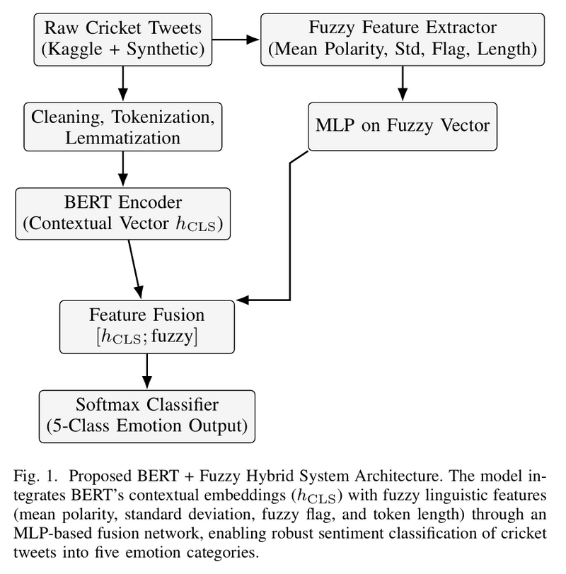
SYSTEM ARCHITECTURE
8

Slide 9
METHODOLOGY
Models Compared:
CNN Feature-Ensemble (Phan et al., IEEE Access 2020 [1])
BERT Baseline (Devlin et al., NAACL 2019 [2])
Proposed BERT + Fuzzy Hybrid Model
Dataset: 65,804 tweets (real + 5,000 synthetic fuzzy).
Preprocessing: Cleaning, tokenization, lemmatization, noise removal.
Feature Extraction:
BERT → Context embeddings
Fuzzy → Polarity, deviation, ambiguity
CNN → Local text patterns
Training: AdamW optimizer, 80:20 split, early stopping.
Metrics: Accuracy, Precision, Recall, F1-Score.
9

Slide 10
ALGORITHMS
Model 1: CNN Feature-Ensemble [1]
Adapted from Phan et al., IEEE Access (2020).
Uses 1D Convolution + Max Pooling to extract local text patterns.
Input features: Token embeddings, POS tags, and polarity sequences.
Outputs sentiment through a dense softmax layer.
Acts as the baseline model for fuzzy sentiment tweets.
10

Slide 11
ALGORITHMS
Model 2: BERT Baseline [2]
Adapted from Devlin et al., NAACL (2019).
Uses Bidirectional Encoder Representations from Transformers (BERT).
Encodes each tweet and uses the [CLS] token for sentiment classification.
Provides strong contextual understanding, but lacks fuzzy reasoning.
11

Slide 12
ALGORITHMS
Model 3: Proposed BERT + Fuzzy Hybrid
Integrates BERT embeddings with fuzzy features (mean polarity, std deviation, ambiguity flag, token count).
Fuzzy features → processed by MLP → concatenated with BERT’s [CLS] output.
Classified via softmax layer into 5 sentiment classes.
12

Slide 13
DATASETS
Total Tweets: 65,804
60,804 real (Kaggle) + 5,000 synthetic fuzzy tweets.
Sentiment Classes (5): Elated, Pleased, Unbiased, Displeased, Frustrated
Train–Test Split: 80% (52,643) → Train & 20% (13,161) → Test
Purpose of Synthetic Tweets: To enhance fuzzy and ambiguous emotion coverage.
Preprocessing: Cleaning, tokenization, lemmatization, noise removal.
13

Slide 14
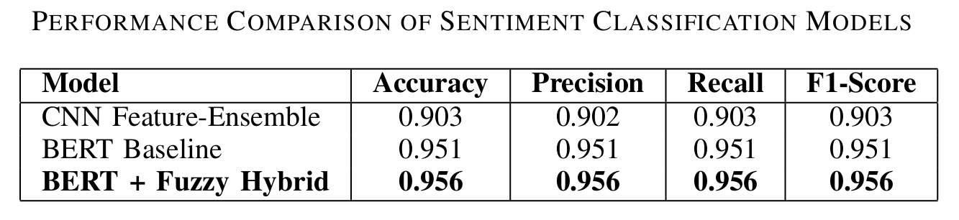
RESULTS
Class-wise Highlights:
Highest performance in Unbiased (0.97 F1) and Elated (0.96 F1) categories.
Slightly lower (but strong) results in Displeased and Frustrated due to complex expressions.
Key Observation:
Hybrid model outperformed all baselines by effectively handling fuzzy and ambiguous sentiments.
14

Slide 15
CONCLUSION
A hybrid CNN–BERT–Fuzzy model was developed for sentiment analysis of cricket tweets.
It effectively captures contextual meaning and handles fuzzy or ambiguous emotions.
Achieved 95.6% accuracy, outperforming CNN and BERT baselines.
The integration of fuzzy linguistic features improved interpretability and robustness.
Demonstrates strong potential for real-time sports sentiment analysis and broader NLP tasks.
15

Slide 16
APPLICATIONS AND FUTURE SCOPES
Applications
Sports Analytics: Helps broadcasters, teams, and sponsors analyze fan emotions in real time.
Decision Support: Provides actionable insights on player performance and public reactions.
Future Scopes
Multilingual Expansion: Extend to Hinglish and other Indian languages.
Real-time System: Develop a live dashboard for dynamic sentiment tracking.
16

Slide 17
REFERENCES
[1] H. T. Phan, H. M. Nguyen, and T. L. Do, “Improving the Performance of Sentiment Analysis of Tweets Containing Fuzzy Sentiment Using the Feature Ensemble Model,” IEEE Access, vol. 8, pp. 216834–216846, 2020.
[2] J. Devlin, M.-W. Chang, K. Lee, and K. Toutanova, “BERT: Pre-training of Deep Bidirectional Transformers for Language Understanding,” in Proc. NAACL-HLT, 2019, pp. 4171–4186.
[3] N. A. Sharma, A. B. M. S. Ali, and M. A. Kabir, “A review of sentiment analysis: tasks, applications, and deep learning techniques,” Int. J. Data Sci. Anal., vol. 19, pp. 351–388, 2024.
[4] M. Khurana, A. Gulati, and S. Singh, “Sentiment analysis framework of Twitter data using classification,” in Proc. IEEE PDGC, 2018.
[5] M. Rathi, N. Malik, and R. K. Saini, “Sentiment analysis of tweets using machine learning approach,” in Proc. IEEE IC3, 2018.
[6] E. Karthika, R. Murugeswari, and R. Manoranjithem, “Sentiment anal ysis of social media networks using random forest algorithm,” in Proc. IEEE INCOS, 2019.
[7] J. S. Vimali and S. Murugan, “AText-BasedSentimentAnalysisModelusingBi-directional LSTMNetworks,” in Proc. IEEE ICCES, 2021.
17

Slide 18
REFERENCES
[8] S. Wen, X. Zhao, H. Zhao, Y. Zhang, and Z. Lu, “Memristive LSTM Network for Sentiment Analysis,” IEEE Trans. Systems, Man, and Cybernetics, vol. 51, no. 3, pp. 1794–1804, 2021.
[9] Y. Wu, Z. Jin, C. Shi, P. Liang, and T. Zhan, “Research on the Appli cation of Deep Learning-based BERT Model in Sentiment Analysis,” arXiv preprint arXiv:2403.08217, 2024.
[10] T. Wang, L. Lu, K. Chow, and J. Zhu, “COVID-19 Sensing: Negative Sentiment Analysis via BERT Model,” IEEE Access, 2020.
[11] L. Yang, S. Zhang, H. Chen, and Y. Zhao, “Sentiment analysis for e commerce product reviews in Chinese based on sentiment lexicon and deep learning,” IEEE Access, vol. 8, pp. 23522–23530, 2020.
[12] K. Dashtipour, M. Gogate, A. Hussain, and F. Cambria, “A hybrid Persian sentiment analysis framework integrating dependency grammar and deep neural networks,” Neurocomputing, vol. 380, pp. 1–10, 2020. [13] A. Rezaeinia, R. Rahmani, A. Ghodsi, and H. Veisi, “Improving pre trained word embeddings for sentiment analysis using POS and lexicon information,” Information Sciences, vol. 369, pp. 188–198, 2016. [14] M. Al-Twairesh, H. Al-Khalifa, and A. Al-Salman, “Surface and deep features in Arabic sentiment analysis,” IEEE Trans. Affective Computing, 2018.
18

Slide 19
REFERENCES
[15] P. Phulare and S. Deshmukh, “Cricket Twitter Data Sentiment Analysis and Prediction Exerted Machine Learning,” in Proc. IEEE CENTCON, 2021.
[16] A. Chaudhari, K. Kumbhare, and R. Patel, “Comparison of Sentiment Analysis Algorithms using Twitter Dataset for Real-Time Analysis of Cricket Sport,” in Proc. IEEE IDCIoT, 2024.
[17] K. Dheemonth, R. Shankar, and B. P. Singh, “Sentiment Analysis on Cricket Tweets using NLP++,” in Proc. IEEE ICCCNT, 2024.
[18] K. Sharma, L. Hota, V. Tikkiwal, and A. Kumar, “Exploring Twitter Sentiments for Predicting Match Outcomes in the Game of Cricket,” Procedia Computer Science, vol. 235, pp. 152–162, 2024.
[19] C. R. Aydin and T. Gungor, “Combination of Recursive and Recurrent Neural Networks for Aspect-Based Sentiment Analysis,” IEEE Access, 2020.
[20] Y. Ren, R. Wang, and D. Ji, “A topic-enhanced word embedding for Twitter sentiment classification,” Information Sciences, vol. 369, pp. 188–198, 2016.
[21] A. Mukwazvure and K. Supreethi, “A hybrid approach to sentiment analysis of news comments,” in Proc. IEEE ICRITO, 2015.
19

Slide 20
REFERENCES
[22] F. M. Kundi, S. Ahmad, A. Khan, and M. Asghar, “Detection and scoring of Internet slangs for sentiment analysis using SentiWordNet,” Life Science Journal, vol. 11, no. 9, 2014.
[23] H. Ye, Z. Liu, T. Chen, and J. Wang, “Combining sentiment lexicons and contextual embeddings for fuzzy sentiment detection,” IEEE Access, 2023.
[24] R. Jena, “An empirical case study on Indian consumers’ sentiment towards electric vehicles,” Industrial Marketing Management, vol. 90, pp. 605–616, 2020.
[25] N. Chauhan and S. Dey, “A fuzzy logic-based hybrid sentiment model for ambiguous product reviews,” Expert Systems with Applications, vol. 218, 2023.
[26] M. Liu, X. Zhang, and Y. Sun, “Deep fusion of sentiment features for domain-specific opinion mining,” Information Processing & Manage ment, vol. 61, 2024.
20

Slide 21


THANK YOU

